Slide 1
V6 basics

Slide 2





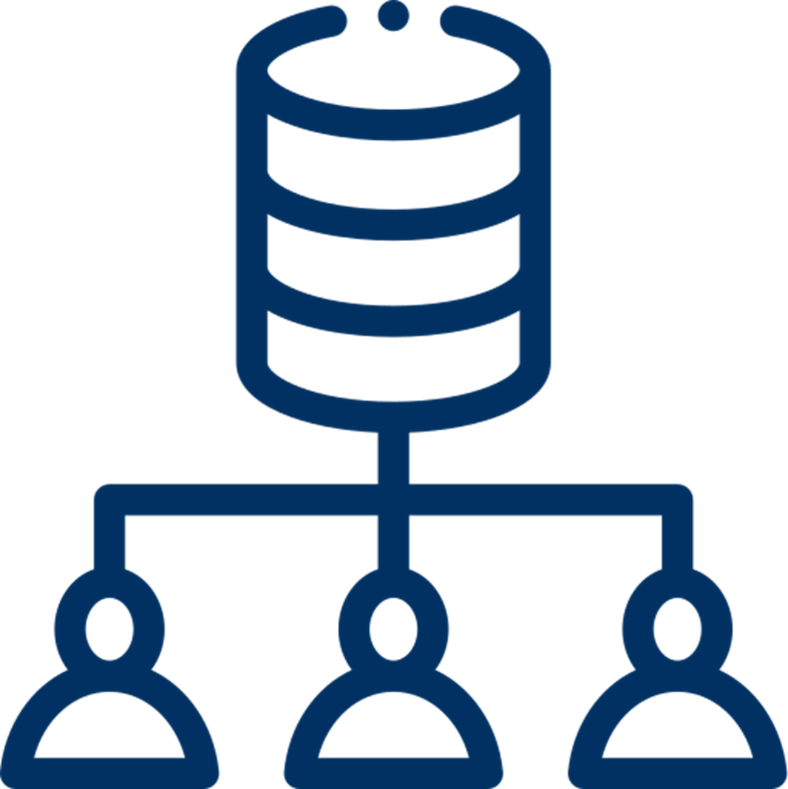

Why using vantage6
Open source
Container orchestration for PETs
Extensible to different data source types
Algorithms in any language
Other applications can connect using the API
Managing collaboration policies
Minimal network requirements
* PET = Privacy Enhancing Technique
Notes:
Open source
Container orchestration for privacy enhancing techniques
Easily extensible to different types of data sources
Algorithms can be developed in any language
Other applications can connect using the API

Slide 3
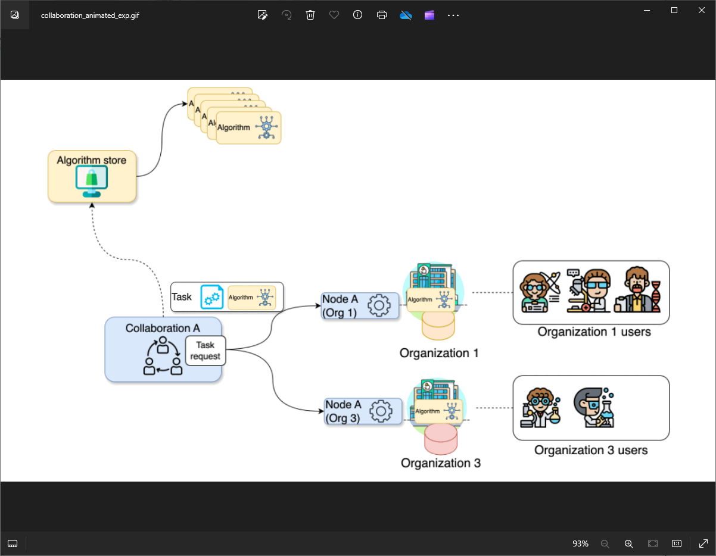
Federated analysis projects with vantage6
vantage6 encompasses a project administration system that allows the user to manage permissions and access to the resources, while assuring the protection of the data.

Slide 4
Federated analysis projects with vantage6
Organization
A group of users that share a common goal or interest (e.g., a consortium, an institute, etc.).

Slide 5
Federated analysis projects with vantage6
Collaboration
One or more organizations working together towards a shared objective.

Slide 6
Federated analysis projects with vantage6
Node
Component that accesses the organization data and executes algorithms on it.

Slide 7
Federated analysis projects with vantage6
User
A person that belongs to one organization who can create tasks for one or more organizations within a collaboration.

Slide 8
Federated analysis projects with vantage6
Algorithm
A computational model or process which can be securely distributed to nodes for execution on the corresponding organization’s data.

Slide 9
Federated analysis projects with vantage6
Algorithm store
A computational model or process which can be securely distributed to nodes for execution on the corresponding organization’s data.

Slide 10
Federated analysis projects with vantage6
Task
A request for the execution of an algorithm on one or more organizations within a collaboration. They are handled by the corresponding organizations’ nodes.

Slide 11
Federated analysis projects with vantage6

Slide 12
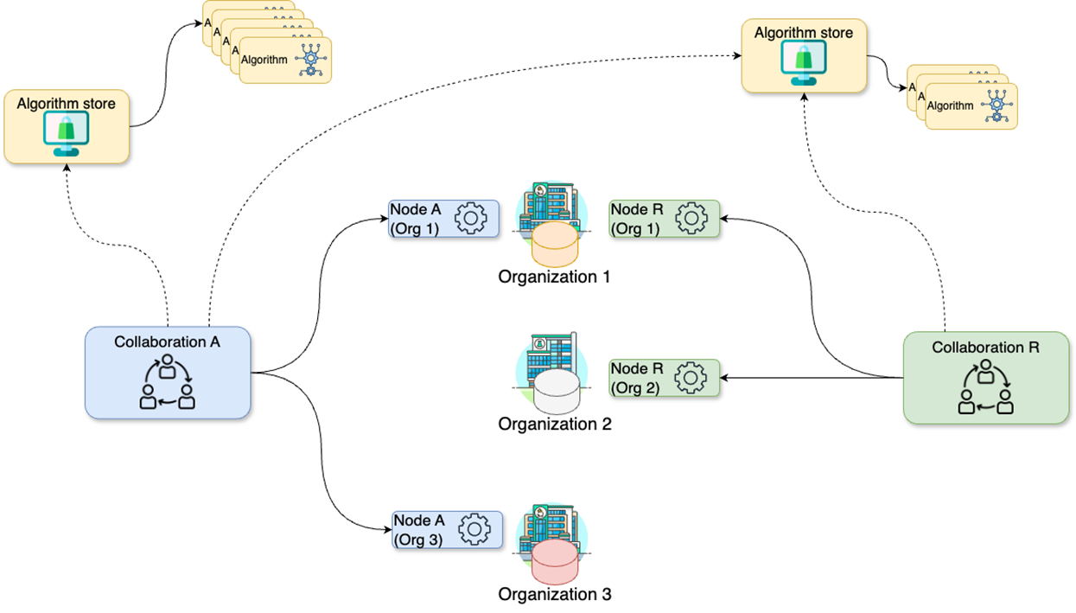
Federated analysis projects with vantage6
Expanding the scenario:
Organizations can take part to multiple collaborations

Slide 13
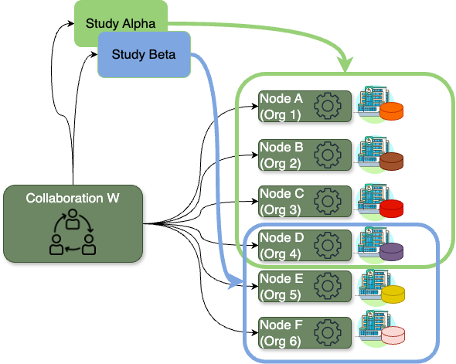
Federated analysis projects with vantage6
Study
A subset of organizations within a collaboration that are engaged in a specific research question. Studies allow a more efficient assignment of tasks to a group of organizations, and a better results management.

Slide 14

Design your own project structure
CHALLENGE
Let’s consider a scenario where you, on behalf of your research institute, want to conduct a new study on a particular illness across three major academic hospitals in the Netherlands: VUmc in Amsterdam, Maastricht UMC+, and UMC Utrecht, as these have valuable data related to the illness. Consider the following:
Your research institute has an existing collaboration (with a different purpose, not related with yours) with UMC Utrecht and UMC Groningen. Hence, there is a vantage6 node already running on your institution for the said collaboration.
You will be conducting this study with a colleague from your institute named Daphne. Both of you are already registered on the organization but without access to the existing collaborations.
How would the concepts described above map to your potential use case?
Which organizations will you need to add to your collaboration?
How many new nodes would you need to set up and on which organizations?
How many users would be created?

Slide 15
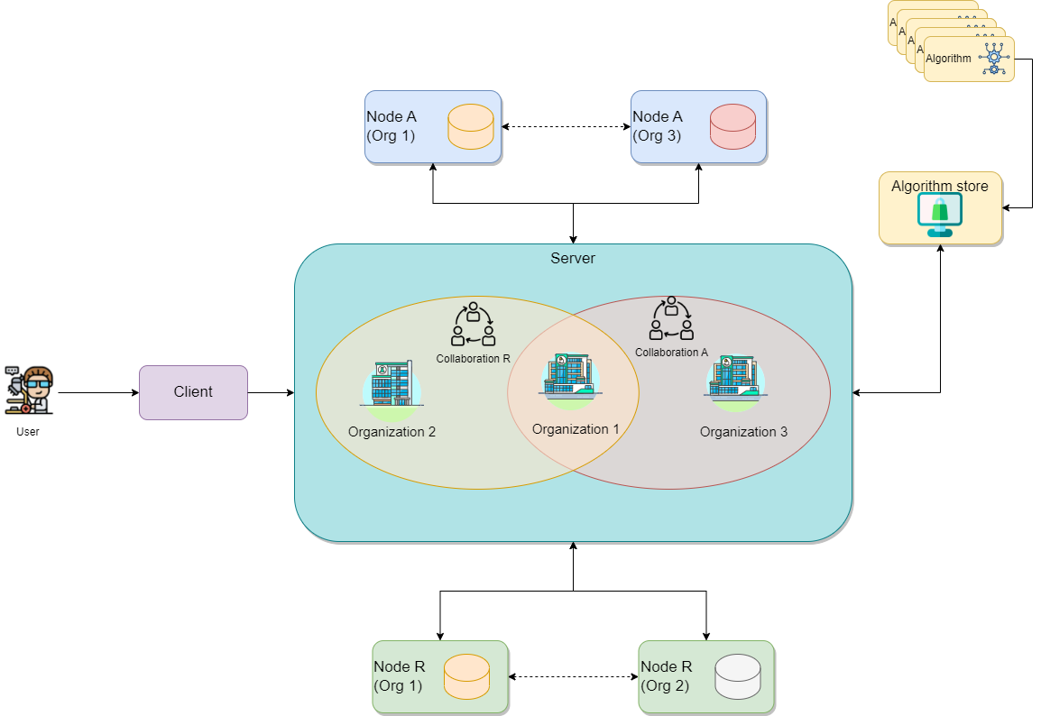
The vantage6 infrastructure
Server
Communication hub between clients and nodes. It contains the users, organizations, collaborations, tasks and their results. It handles authentication and authorization to the system and acts as the communication hub for clients and nodes.

Slide 16
The vantage6 infrastructure
Data station
Hosts the data and the vantage6 node. The vantage6 node executes the allowed algorithms on the local data. The node is responsible for picking up the task and running them in parallel, executing the algorithm and sending the results back to the server.

Slide 17
The vantage6 infrastructure
Client
Entity that interacts with the vnatage6 server via:
API
User interface
Python client

Slide 18
The vantage6 infrastructure
Algorithm store
Repository for trusted algorithms. It allows researchers to explore which algorithms are available and how to run them. Also, the algorithm store integrates additional information to the algorithm metadata such who developed and reviewed the algorithm.

Slide 19
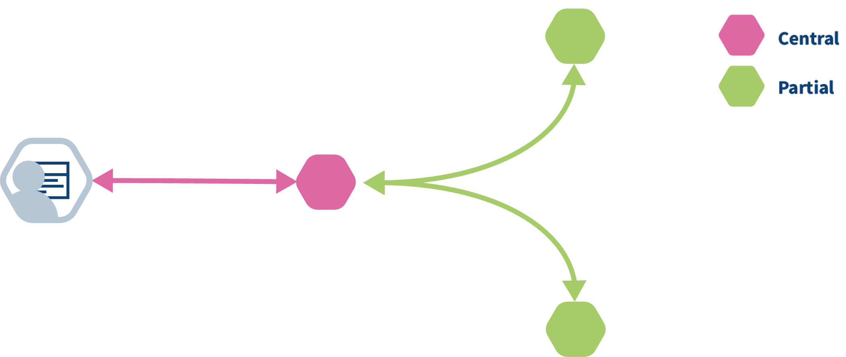
How algorithms run in vantage6
Federated algorithms can be split in a federated and a central part:
Central: The central part of the algorithm is responsible for orchestration and aggregation of the partial results.
Federated: The partial tasks are executing computations on the local privacy sensitive data.
Federated

Slide 20
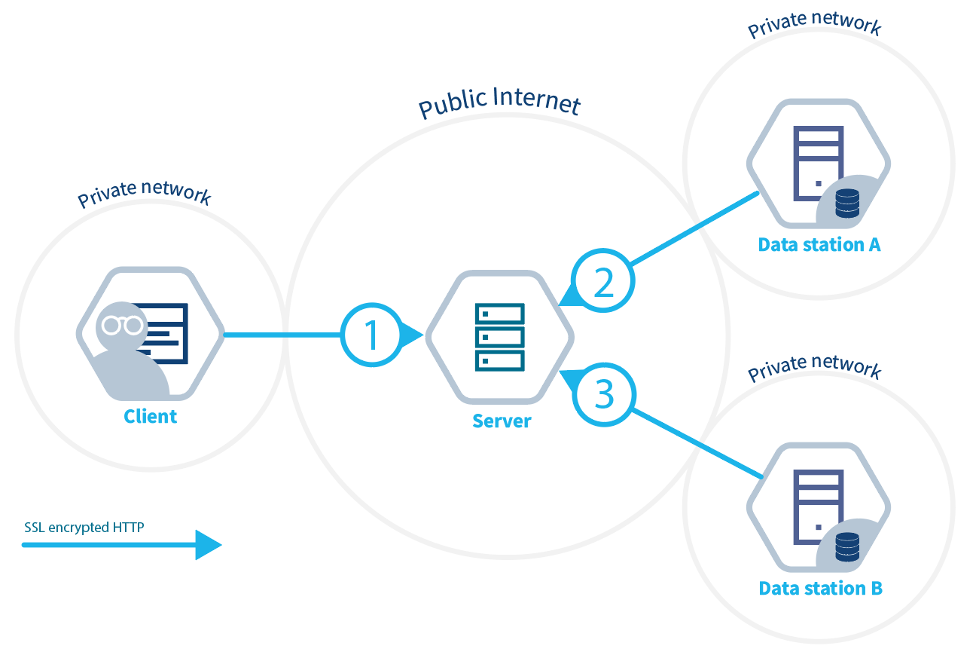
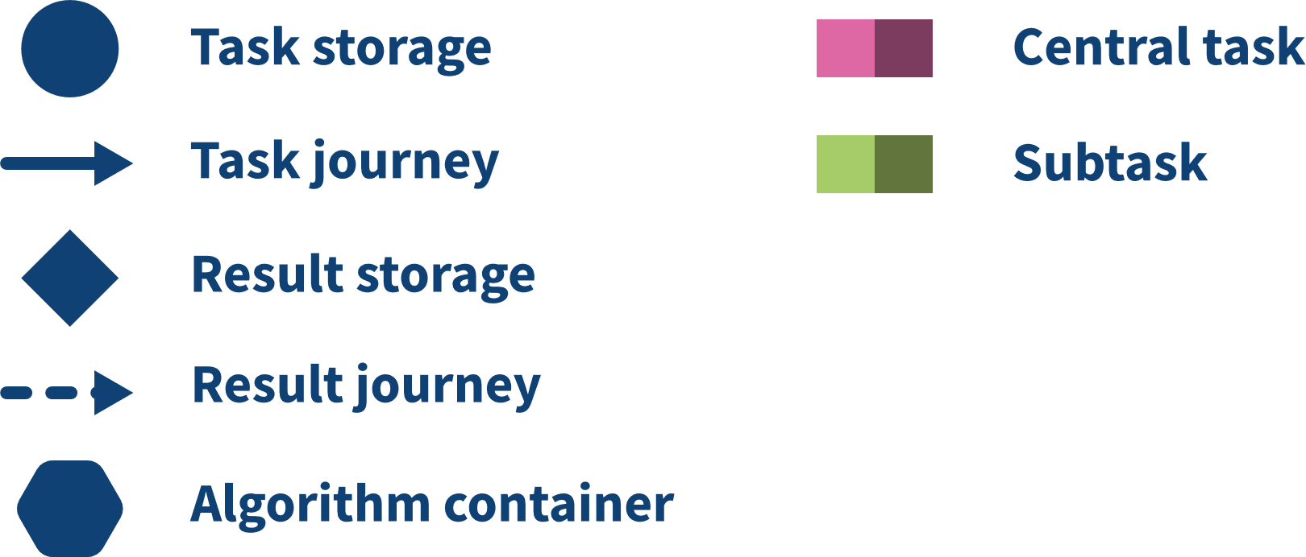

How algorithms run in vantage6

Slide 21
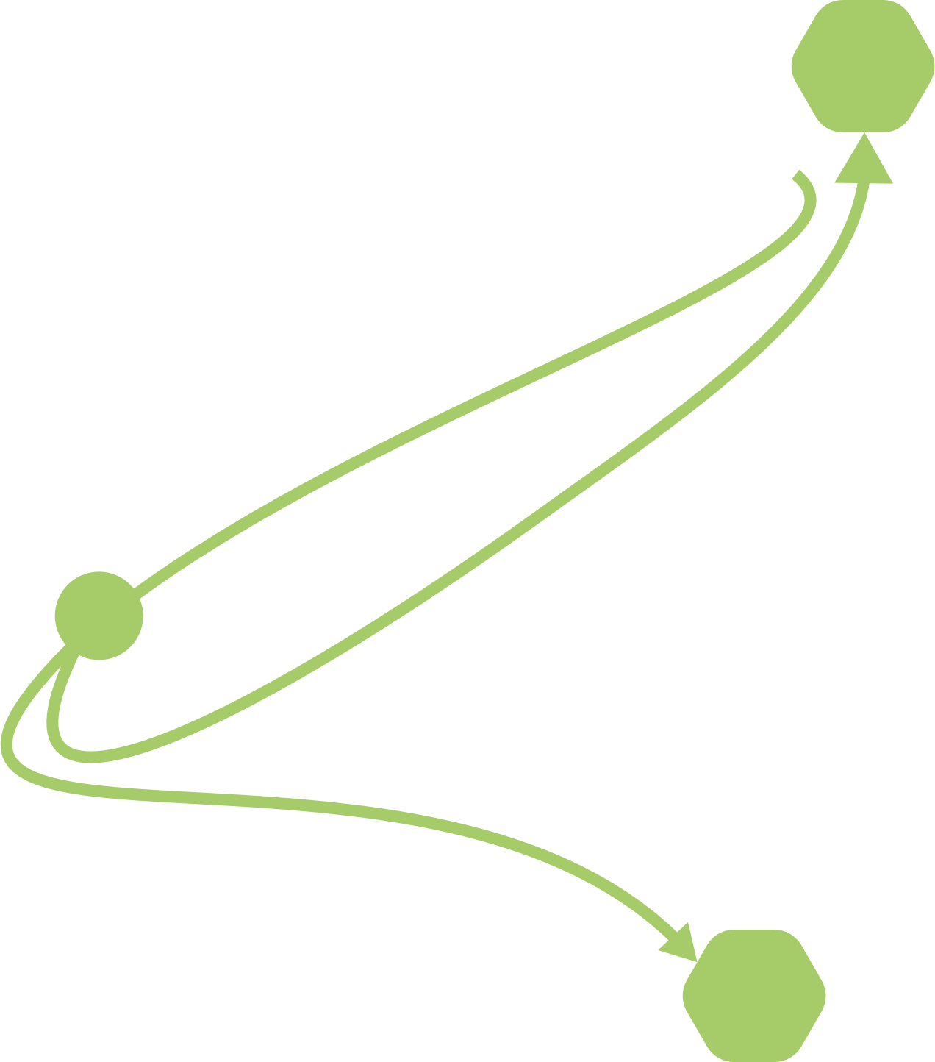
Algorithm projection on infrastructure

Slide 22
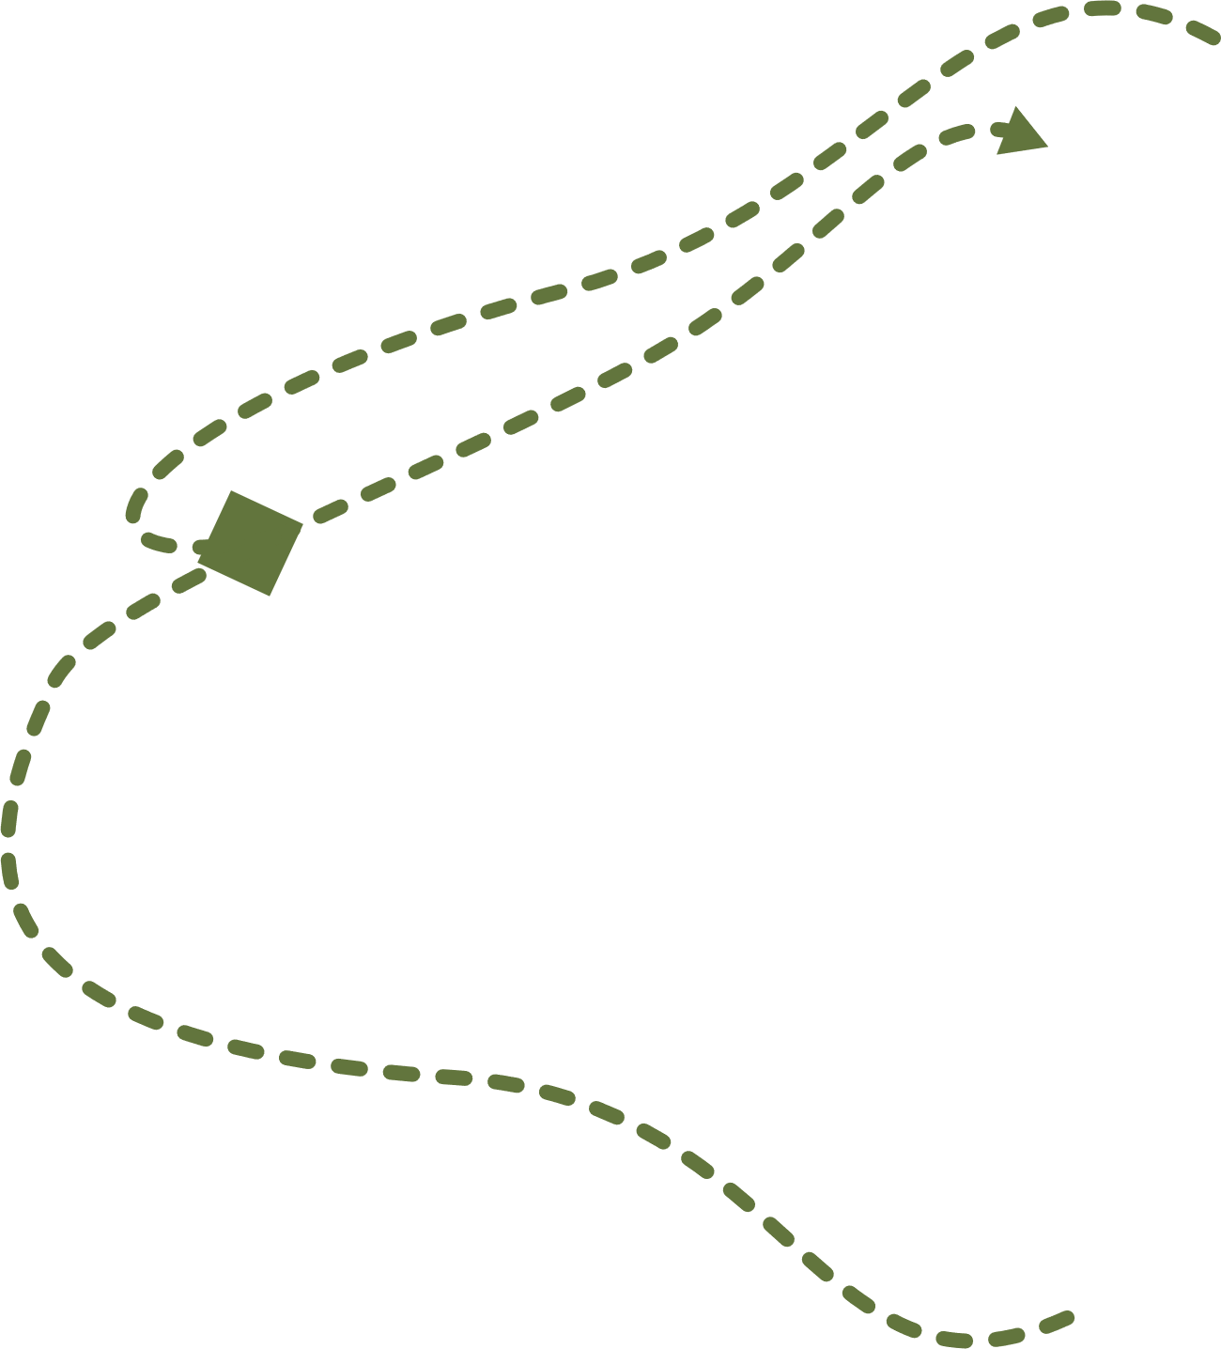
Algorithm projection on infrastructure

Slide 23
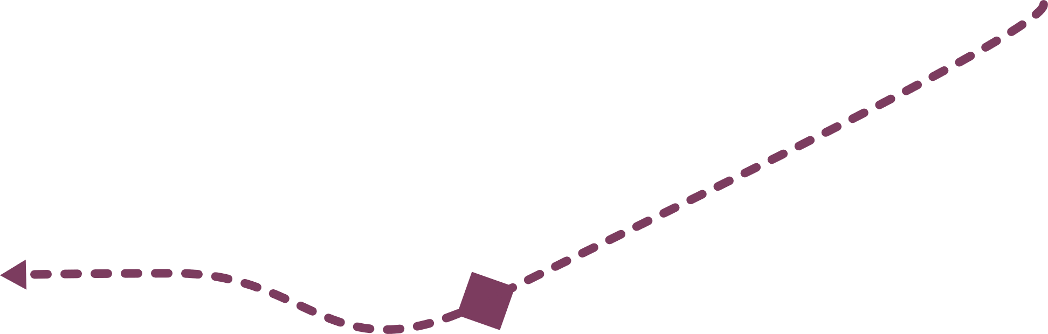
Algorithm projection on infrastructure

Slide 24
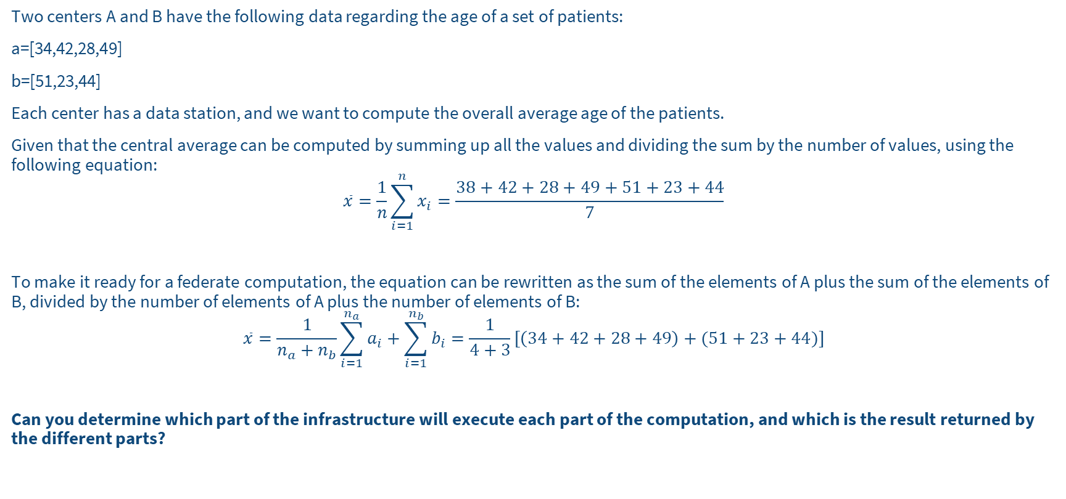
Exercise
CHALLENGE
Two centers A and B have the following data regarding the age of a set of patients:
a=[34,42,28,49]
b=[51,23,44]
Each center has a data station, and we want to compute the overall average age of the patients.
Given that the central average can be computed by summing up all the values and dividing the sum by the number of values, using the following equation:
$$\overline{x}=\frac{1}{n}\sum_{i=1}^{n}{x_{i}=\frac{38+42+28+49+51+23+44}{7}}$$
To make it ready for a federate computation, the equation can be rewritten as the sum of the elements of A plus the sum of the elements of B, divided by the number of elements of A plus the number of elements of B:
$$\overline{x}=\frac{1}{n_{a}+n_{b}}\sum_{i=1}^{n_{a}}{a_{i}+\sum_{i=1}^{n_{b}}{b_{i}}=\frac{1}{4+3}[\left(34+42+28+49\right)+(51+23+44)]}$$
Can you determine which part of the infrastructure will execute each part of the computation, and which is the result returned by the different parts?

Slide 25
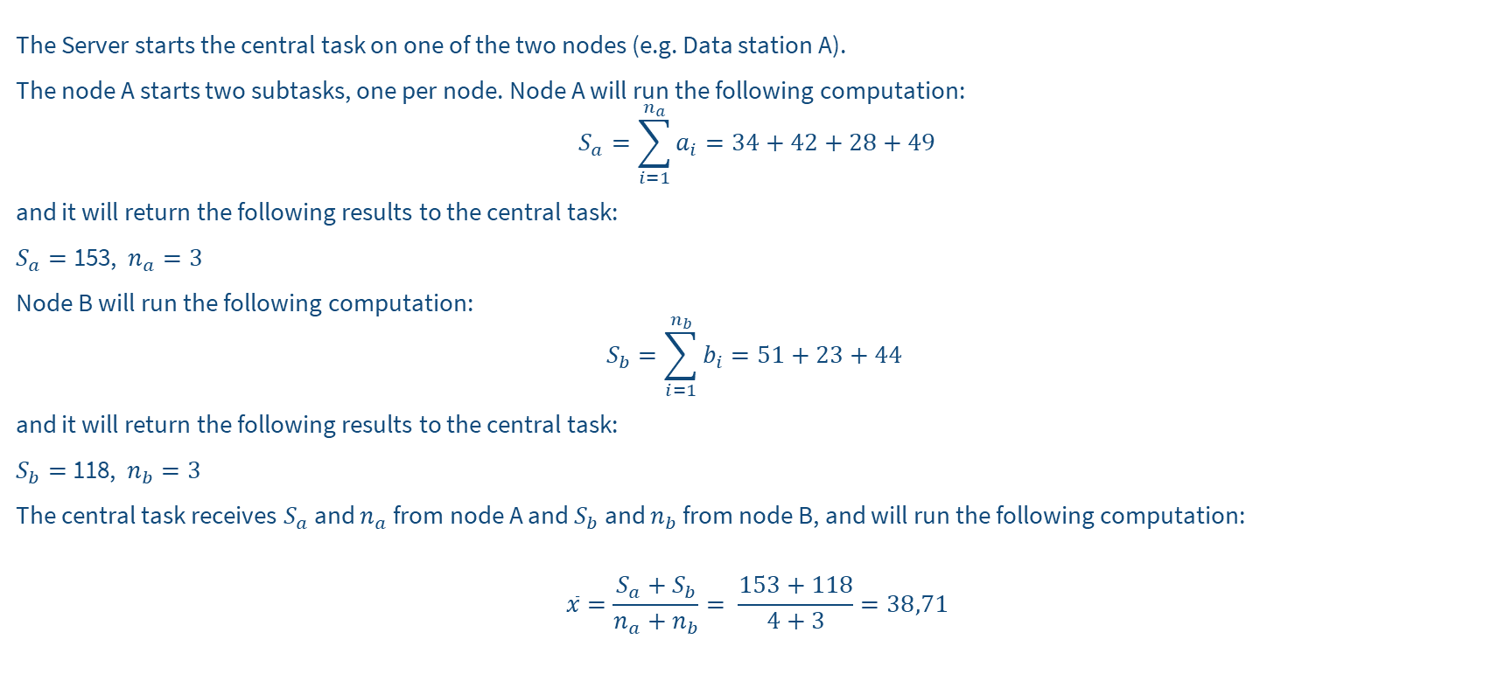
Solution
SOLUTION
The Server starts the central task on one of the two nodes (e.g. Data station A).
The node A starts two subtasks, one per node. Node A will run the following computation:
$$S_{a}=\sum_{i=1}^{n_{a}}{a_{i}=34+42+28+49}$$
and it will return the following results to the central task:
$S_{a}=$153, $n_{a}=3$
Node B will run the following computation:
$$S_{b}=\sum_{i=1}^{n_{b}}{b_{i}=51+23+44}$$
and it will return the following results to the central task:
$S_{b}=$118, $n_{b}=3$
The central task receives $S_{a}$ and $n_{a}$ from node A and $S_{b}$ and $n_{b}$ from node B, and will run the following computation:
$$\overline{x}=\frac{S_{a}+S_{b}}{n_{a}+n_{b}}= \frac{153+118}{4+3}=38,71$$

Slide 26
Future developments of vantage6
Policies: we want to extend the current available policies to a more generic policy framework in which any aspect of the vantage6 platform can be controlled by policies. This will maximize the flexibility of the platform and make it easier to adapt to new use cases.
Model repository: Currently, vantage6 is focused on privacy enhancing techniques. Some of these techniques result in a model that can be used to make predictions. We want to extend vantage6 with a model repository in which these models can be stored, shared and used. This will make it easier to reuse models and to compare the performance of different models.

